Slide 1
COVID19 PREDICTION WITH
DEEP LEANRING ON NEURAL NETWORKS
PRESENTED BY :
MAHENDRA SRIRAM BETHA(700757819),
SANGEETHA BADDAM(700757191),
SAMPATH PANDULA(700758258),
CHARITHA GONGATI(700756538)

Slide 2
Roles and Responsibilities
Each member of the team worked on multiple tasks to accomplish the project:
Sampath and Charitha had contributed to finding the problem statement along with analyzing requirements and planning the project proposal , while the roles of implementation of the algorithm, training the algorithm with data and producing the required results was by Sangeetha and Mahendra.

Slide 3
Motivation
The primary motivation of COVID19 Identification analysis with Deep Learning on Neural Networks is to detect the find out the Covid19 disease in the hospital dataset.
The project evaluation can be tested with the deep learning algorithm prediction results and Convolutional Neural Networks algorithm is chosen to make this more efficient.

Slide 4
OBJECTIVE
The objective of Covid19 disease identification with deep learning is to detect the Covid19 disease in the early stage itself with the available attributes.
Data in the datasets are pre-processed, to remove noisy and null values. So that the data can be analyzed and visualized for further processing.
It will be helpful in all the hospital patient records to detect the Covid19 disease.

Slide 5
RELATED WORK
Gozes et al. (2020) developed a computer-aided tool based on AI that analyzes CT images to detect and identify Coronavirus cases automatically.
The tool has shown high accuracy in diagnosing COVID-19 using datasets of Chinese COVID-19 cases.
proposed a diagnostic model based on deep learning to diagnose COVID-19 using high-quality CT chest images, with good accuracy, sensitivity, and specificity results
Yan et al. (2020) presented a prediction approach based on ML techniques that tracks the severe COVID-19 progress and can even identify potential death cases.

Slide 6
RELATED WORK cont.
The proposed model is useful in early diagnosis to avoid the health consequences of COVID-19 and increase the chances of life.
Zheng et al. (2020) proposed another COVID-19 diagnostic tool based on supervised deep learning, which detects COVID-19 by identifying Weak Label for 3D CT Chest imaging.
The tool has shown high accuracy in detecting COVID-19 using collected CT images

Slide 7
PROBLEM STATEMENT
The coronavirus disease (COVID-19) is a highly transmissible public health concern that requires preventative measures to reduce transmission rates
One of the critical investigation methods to detect COVID-19 is chest radiography imaging that screens the chest of infected patients. Initial studies have found that chest radiography images can show the abnormalities of the chest of the people infected with COVID-19
Unfortunately, to the best of the existing work, these current learning approaches can be non-open sourced and not publicly available, which prevent research from accessing and investigating them for further research

Slide 8
LIMITATION OF EXISTING SYSTEM
Less prediction Performance
Less Accuracy

Slide 9
PROPOSED system
The proposed methods aim to find the Covid19 disease with higher standard.
The accuracy levels of the identification of the Covid19 disease will be improved with the proposed system.
The deep learning on neural network will provide the better solution to solve the problem of identification of the Covid19 disease in the real world hospital data.
The Convolutional Neural Network algorithm will check the data in more compact with training and testing the data.
It will provide more accuracy as compared with the other type of techniques.

Slide 10
ADVANTAGES OF PROPOSED SYSTEM
HIGH Performance
Good Accuracy level.

Slide 11
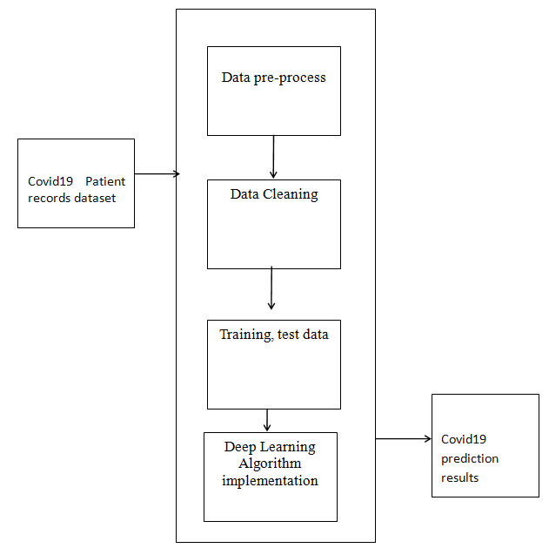
Flow Chart

Slide 12
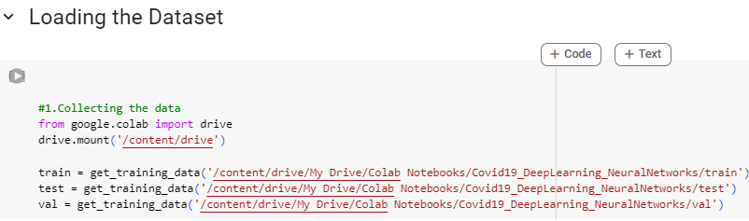
Experimental results
Loading the dataset:

Slide 13
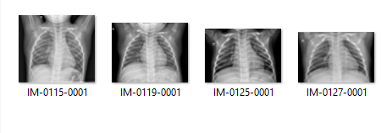
Experimental results
The information about the Covid19 patient records with different types of attributes are collected from Kaggle data. The dataset total contains of image dataset with training and testing Covid19 affected images of patients.

Slide 14
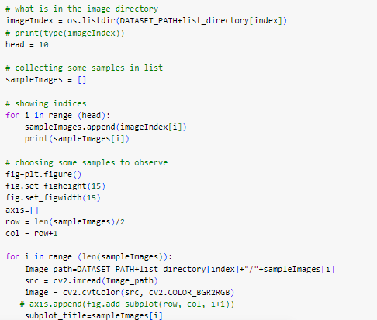
Experimental results
The pre-processing is applied to the dataset where all the noisy data are removed and the image is reshaped as per the mapping of 255pixel.

Slide 15
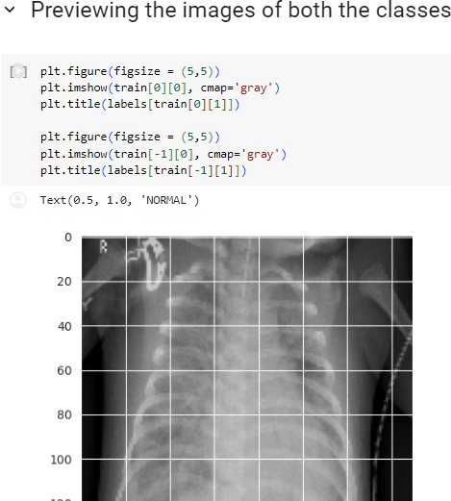
Experimental results
The image dataset is divided into testing and training to pass in to the neural network model.

Slide 16
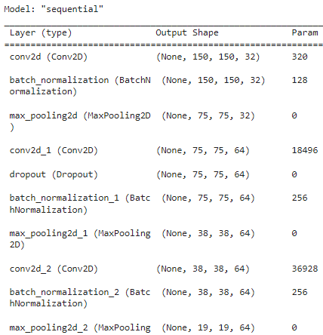
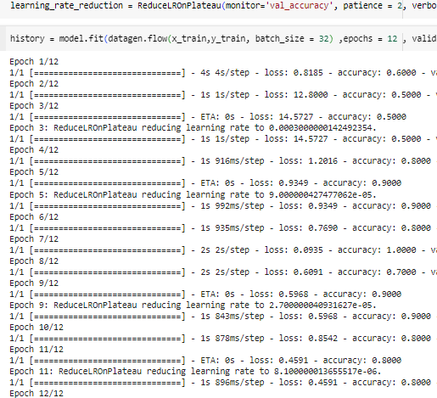
Experimental results
The Convolutional Neural Networks algorithm is applied with creating the sequential model. The output of the sequential model with layers is displayed.

Slide 17
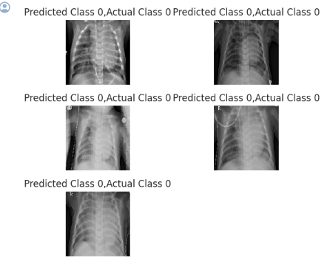
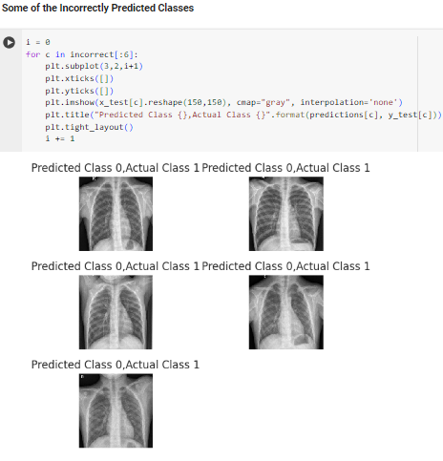
Experimental results
The results of the prediction of Covid19 disease identification with the CNN provide the accuracy results.
Prediction results
Incorrect Predictions

Slide 18
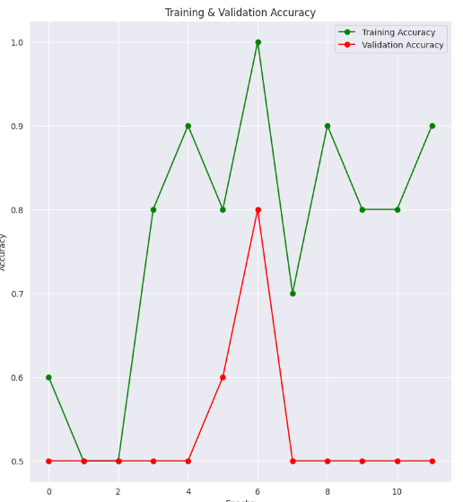
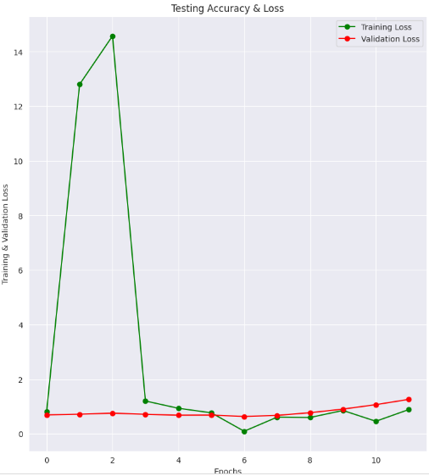
Experimental results

Slide 19
CONCLUSION
A cutting-edge framework for detecting Covid19 diseases has been developed using deep neural networks and diverse medical data.
The framework employs all X-ray images with Covid19 information for model training and data classification.
This methodology greatly enhances diagnostic accuracy compared to traditional approaches, demonstrating that integrating advanced deep learning with medical expertise is an effective way to diagnose neurological disorders in their early stages.

Slide 20
REFERENCE
[1] Li, L., Qin, L., Xu, Z., Yin, Y., Wang, X., Kong, B., Bai, J., Lu, Y., Fang, Z., Song, Q. and Cao, K., 2020. Artificial Intelligence Distinguishes COVID-19 from Community Acquired Pneumonia on Chest CT. Radiology, p.200905.
[2] Gozes, O., Frid-Adar, M., Greenspan, H., Browning, P.D., Zhang, H., Ji, W., Bernheim, A. and Siegel, E., 2020. Rapid ai development cycle for the coronavirus (covid-19) pandemic: Initial results for automated detection & patient monitoring using deep learning ct image analysis. arXiv preprint arXiv:2003.05037
[3] MV Villarejo, BG Zapirain, AM Zorrilla.,2013. Algorithms based on CWT and classifiers to control cardiac alterations and stress using an ECG and a SCR. Sensors 13 (5), 6141-6170.
[4] Xu, X., Jiang, X., Ma, C., Du, P., Li, X., Lv, S., Yu, L., Chen, Y., Su, J., Lang, G. and Li, Y., 2020. Deep learning system to screen coronavirus disease 2019 pneumonia. arXiv preprint arXiv:2002.09334
[5] Chen, J., Wu, L., Zhang, J., Zhang, L., Gong, D., Zhao, Y., Hu, S., Wang, Y., Hu, X., Zheng, B. and Zhang, K., 2020. Deep learning-based model for detecting 2019 This work is licensed under a Creative Commons Attribution 4.0 License.

Slide 21
Thank YOU !!!

